Slide 1
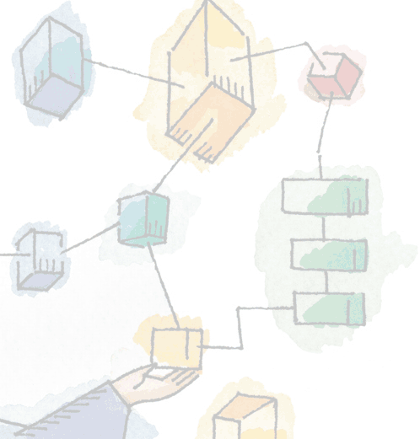
Chapter 3 Process Description and Control
Operating Systems: Internals and Design Principles, 6/E William Stallings

Slide 2
Requirements of an Operating System
Interleave the execution of multiple processes, to maximize processor utilization while providing reasonable response time
Allocate resources to processes
Support interprocess communication and user creation of processes

Slide 3
Concepts
Computer platform consists of a collection of hardware resources
Computer applications are developed to perform some task
Inefficient for applications to be written directly for a given hardware platform

Slide 4
Concepts
OS provides a convenient, feature rich, secure, and consistent interface for applications to use
OS provides a uniform, abstract representation of resources that can be requested and accessed by application

Slide 5
Manage Execution of Applications
Resources made available to multiple applications
Processor is switched among multiptle application
The processor and I/O devices can be used efficiently

Slide 6
Process
A program in execution
An instance of a program running on a computer
The entity that can be assigned to and executed on a processor
A unit of activity characterized by the execution of a sequence of instructions, a current state, and an associated set of system instructions

Slide 7
Process Elements
Identifier
State
Priority
Program counter

Slide 8
Process Elements
Memory pointers
Context data
I/O status information
Accounting information

Slide 9
Process Control Block
Contains the process elements
Created and manage by the operating system
Allows support for multiple processes

Slide 10
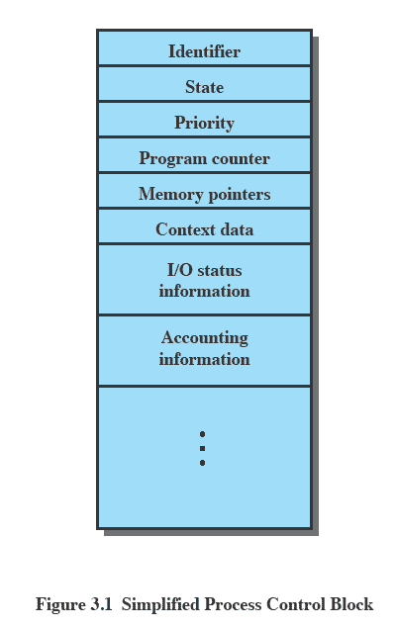
Process Control Block

Slide 11
Trace of the Process
Sequence of instruction that execute for a process
Dispatcher switches the processor from one process to another

Slide 12
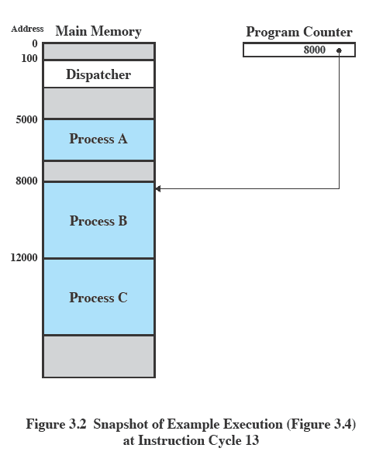
Example Execution

Slide 13
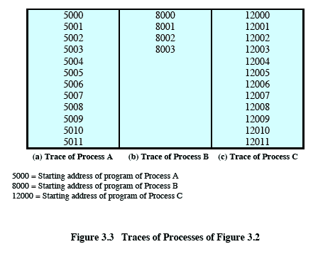
Trace of Process

Slide 14
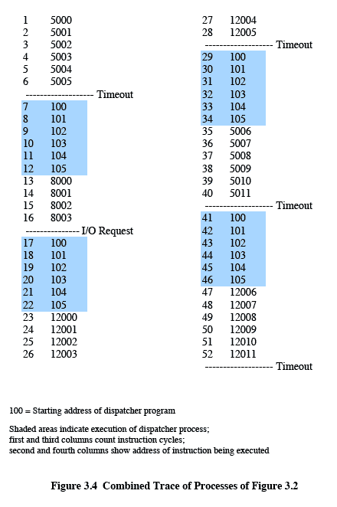
Combined Trace of Process

Slide 15
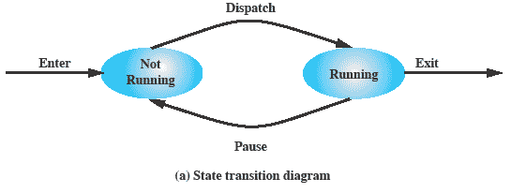
Two-State Process Model
Process may be in one of two states
Running
Not-running

Slide 16
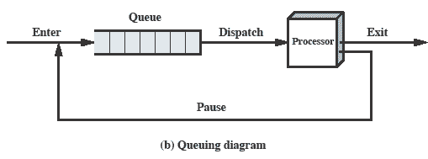
Queuing Diagram

Slide 17
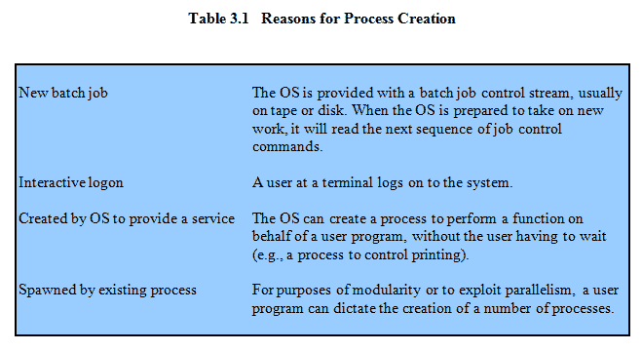
Process Creation

Slide 18
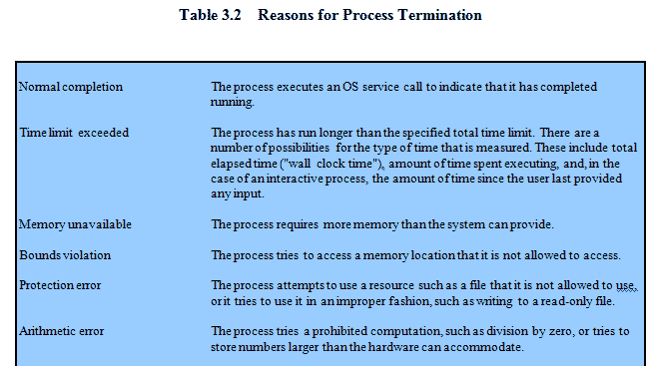
Process Termination

Slide 19
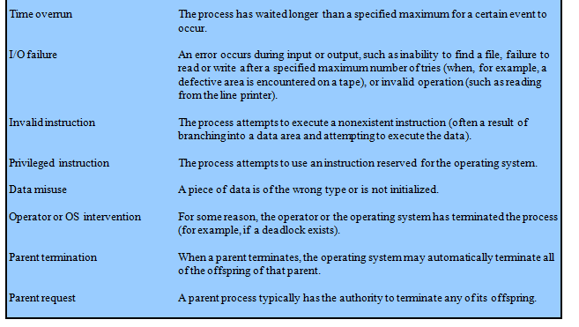
Process Termination

Slide 20
Queuing
Processes
Not-running ready to execute
Not-running block
Dispatcher must scan list to find process not-running, ready, and in queue the longest

Slide 21
A Five-State Model
Running
Ready
Blocked
New
Exit

Slide 22
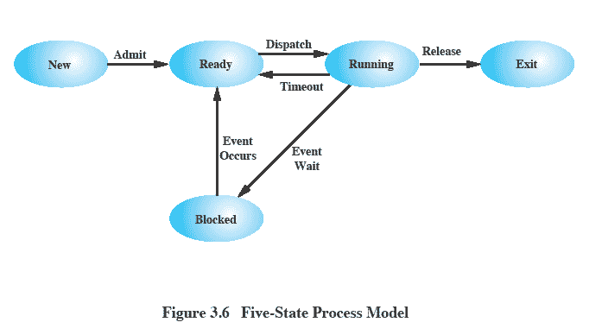
Five-State Process Model

Slide 23
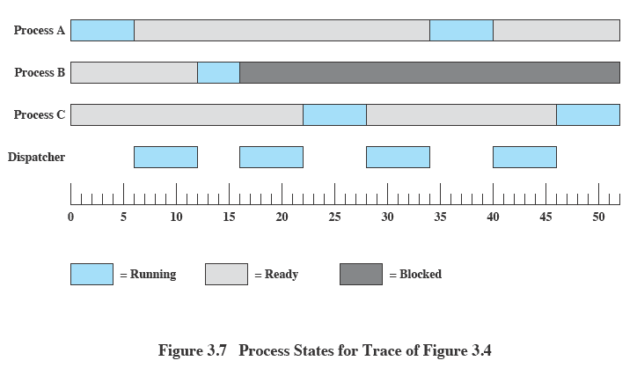
Process States

Slide 24
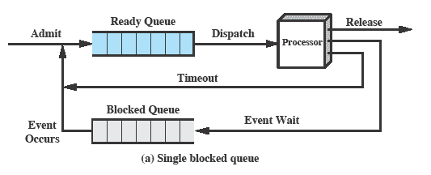
Using Two Queues

Slide 25
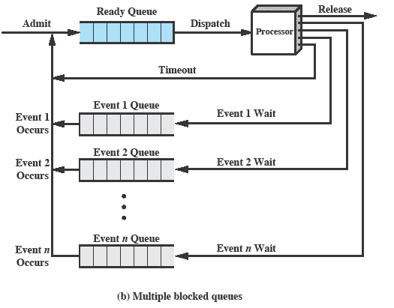
Multiple Blocked Queues

Slide 26
Suspended Processes
Processor is faster than I/O so all processes could be waiting for I/O
Swap these processes to disk to free up more memory
Blocked state becomes suspend state when swapped to disk
Two new states
Blocked/Suspend
Ready/Suspend

Slide 27
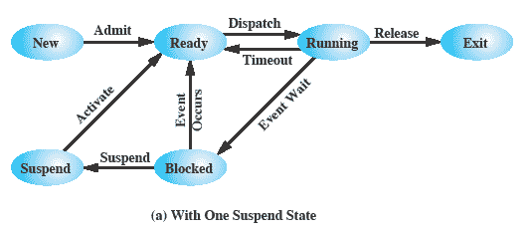
One Suspend State

Slide 28
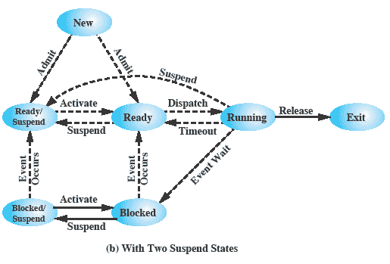
Two Suspend States

Slide 29
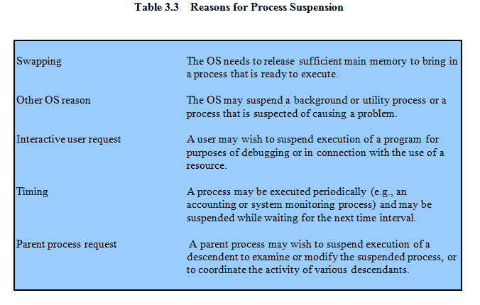
Reason for Process Suspension

Slide 30
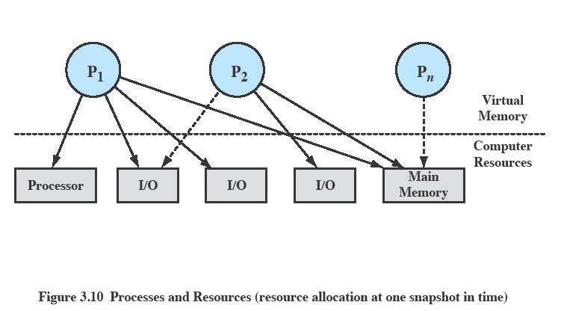
Processes and Resources

Slide 31
Operating System Control Structures
Information about the current status of each process and resource
Tables are constructed for each entity the operating system manages

Slide 32
Memory Tables
Allocation of main memory to processes
Allocation of secondary memory to processes
Protection attributes for access to shared memory regions
Information needed to manage virtual memory

Slide 33
I/O Tables
I/O device is available or assigned
Status of I/O operation
Location in main memory being used as the source or destination of the I/O transfer

Slide 34
File Tables
Existence of files
Location on secondary memory
Current Status
Attributes
Sometimes this information is maintained by a file management system

Slide 35
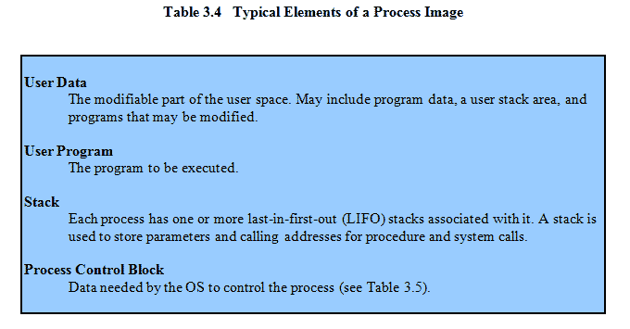
Process Tables
Manage processes
Process control block
Process image is the collection of program. Data, stack, and attributes

Slide 36
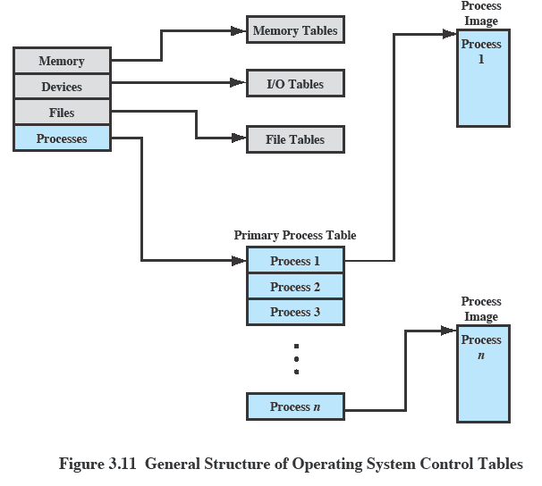
OS Control Tables

Slide 37
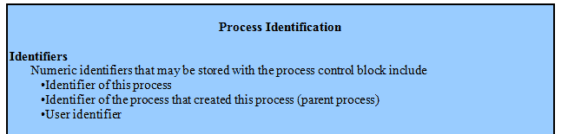
Elements of a Process Control Block

Slide 38
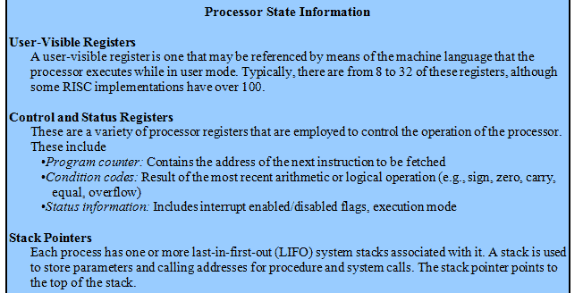
Elements of a Process Control Block

Slide 39
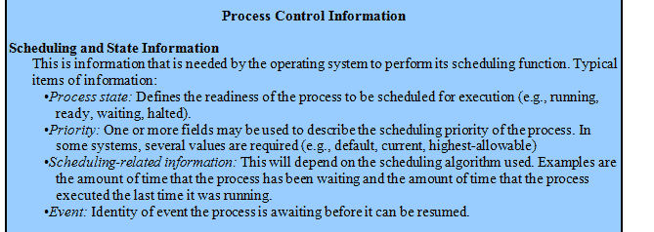
Elements of a Process Control Block

Slide 40
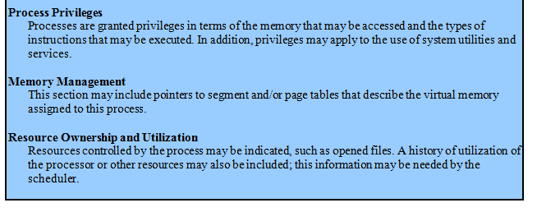
Elements of a Process Control Block

Slide 41
Processor State Information
Contents of processor registers
User-visible registers
Control and status registers
Stack pointers
Program status word (PSW)
contains status information
Example: the EFLAGS register on Pentium processors

Slide 42
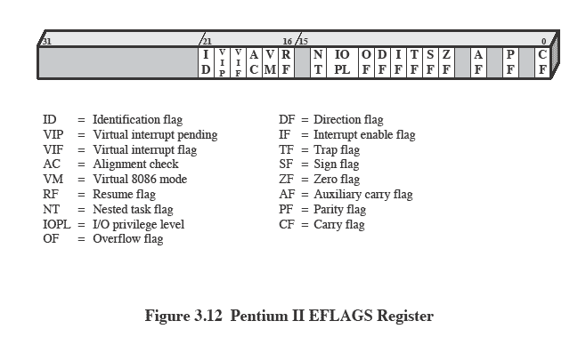
Pentium II EFLAGS Register

Slide 43
Modes of Execution
User mode
Less-privileged mode
User programs typically execute in this mode
System mode, control mode, or kernel mode
More-privileged mode
Kernel of the operating system

Slide 44
Process Creation
Assign a unique process identifier
Allocate space for the process
Initialize process control block
Set up appropriate linkages
Create or expand other data structures

Slide 45
When to Switch Process
Clock interrupt
process has executed for the maximum allowable time slice
I/O interrupt
Memory fault
memory address is in virtual memory so it must be brought into main memory

Slide 46
When to Switch a Process
Trap
error or exception occurred
may cause process to be moved to Exit state
Supervisor call
such as file open

Slide 47
Change of Process State
Save context of processor including program counter and other registers
Update the process control block of the process that is currently in the Running state
Move process control block to appropriate queue – ready; blocked; ready/suspend

Slide 48
Change of Process State
Select another process for execution
Update the process control block of the process selected
Update memory-management data structures
Restore context of the selected process

Slide 49
Execution of the Operating System
Non-process Kernel
Execute kernel outside of any process
Operating system code is executed as a separate entity that operates in privileged mode
Execution Within User Processes
Operating system software within context of a user process

Slide 50
Execution of the Operating System
Process-based operating system
Implement the OS as a collection of system process

Slide 51
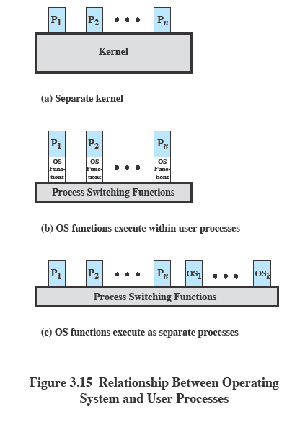
Execution of the Operating System

Slide 52
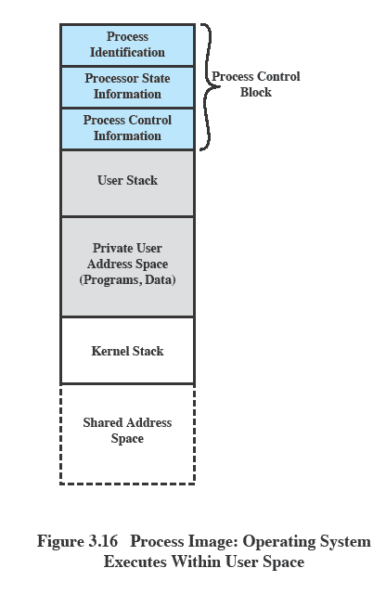
OS Executes in User Space

Slide 53
Security Issues
System access threats
Intruders
Malicious software

Slide 54
Security Issues
Countermeasures
Intrusion detection
Authentication
Access control
Firewalls

Slide 55
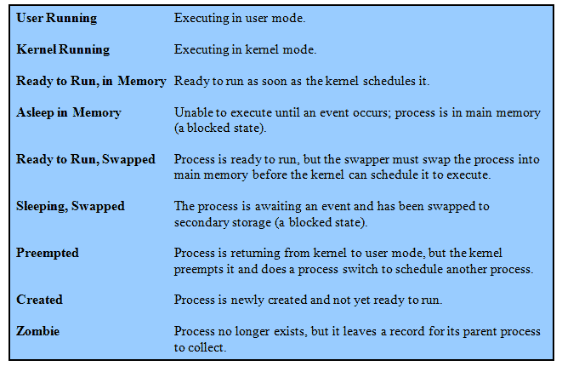
UNIX Process States

Slide 56
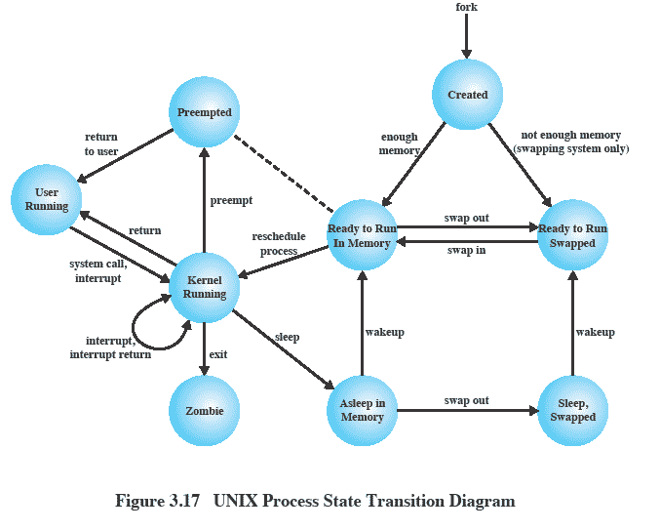
UNIX Process State Transition Diagram

